Slide 1
Het cardiale lymfoom
Ilse Kuipers, 11 oktober 2018
Notes:
Tirade

Slide 2

“God zende jou de bloedkanker achter je hart, dat de dokter lang zoeken zal hebben”
xxxxxxxxxxxxxxxxxxxxxxxxxxxxxxxxxxxxxxxxxxxxxxxxxxxxxxxxxxxxxxxxxxxxxxxxxxxxxxxxxxxxxxxxxxxxxxxxxxxxxxxxxxxxxxxxxxxxxxxxxxxxxxxxxxxxxxxxxxxxxxxxxxxxxxxxxxxxxxxxxxxxxxxxxxxxxxx
Gerard Reve

Slide 3
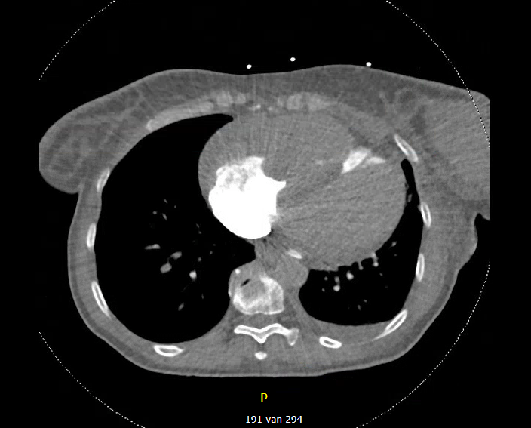
Patiënte A, 66 jaar
xxxxxxxxxxxxxxxxxxxxxxxxxxxxxxxxxxxxxxxxxxxxxxxxxxxxxxxxxxxxxxxxxxxxxxxxxxxxxxxxxxxxxxxxxxxxxxxxxxxxxxxxxxxxxxxxxxxxxxxxxxxxxxxxxxxxxxxxxxxxxxxxxxxxxxxxxxxxxxxxxxxxxxxxxxxxxxx
Blanco voorgeschiedenis
Anamnese
  Progressieve dyspnoe sinds 3 dagen
  Sinds 2,5 week een massa in haar linker mamma
  Collaps → naar SEH
Lichamelijk onderzoek
  Bloeddruk 80/40 mmHg, pols 140, Sat 85-92%, EMV max
  Palpabele massa in linker mamma
Notes:
In the last couple of months we were confronted with 3 cases of a rare disease entity. During this presentation I would like to present these cases and discus some literature.
During spring a 66 year old female presentated at the emergency department with difficulty breathing which started 3 days ago. She visited her general practionar were she collapsed and was referred to the ER.
Besides her dyspnoe, she mentioned a mass in her left mamma. She had no medical history and was not using medication.
In the ER she was hypotensive with a tachycardia. Her oxygen saturation was low. Her EMV status was maximal.
There were normal heart and breath sounds. And there was palpabel mass in her left mamma. No lymfadenopathy.
Contrast computed tomography revealed a large mass within the right ventricle, obliterating the lumen.
It also showed a large mass in the left mamma and mediastinal lymfadenopathy.
Also bilateral pulmonal embolies were seen.
LDH 926
CT volgens longembolieprotocol met i.v. contrast, 1 mm coupes.
Geen voorgaand onderzoek
Goed contrastaanbod, bilateraal segmentele vullingsdefecten: longembolie.
Vergroot corvolume, met grillige massa rechter hart met obliteratie rechter ventrikel basaal.
Beperkte pericardvocht. Forse backflow tot intrahepatisch.
Massale pathologisch vergrote lymfeklieren mediastinaal; met taillering van de linkerhoofdstambronchus.
Centrilobulair emfyseem.
Geen consolidaties, links basaal beperkt pleuravocht.
Geen pneumothorax.
Grote massa linkermamma.
Meegescande bovenbuik niet goed te beoordelen.
Normaal skelet.
Conclusie
Bilateraal Segmentele en subsegmentele longembolie .
Forse rechts belasting. Groot grillig vullingsdefect/massa rechter hart
Mediastinale lymfadenopathie; taillering van linkerstambronchus.
Grote mammatumor links.

Slide 4
Patiënte A, 66 jaar
xxxxxxxxxxxxxxxxxxxxxxxxxxxxxxxxxxxxxxxxxxxxxxxxxxxxxxxxxxxxxxxxxxxxxxxxxxxxxxxxxxxxxxxxxxxxxxxxxxxxxxxxxxxxxxxxxxxxxxxxxxxxxxxxxxxxxxxxxxxxxxxxxxxxxxxxxxxxxxxxxxxxxxxxxxxxxxx
Conclusie
  Obstructieve en cardiogene shock door een obstruerende tumor in RV
  Massa in linker mamma met mediastinale lymfadenopathie
  dd: agressief lymfoom/ mammacarcinoom?
  Prednisolon 100mg + consult cardiothoracale chirurgie
Postmortum histologie
  Multifocaal DLBCL in li en re ventrikel
  Lokalisatie in li mamma
  Mediastinale en supraclaviculaire lymfadenopathie
  Subsegmentele longembolieën
Notes:
The conclusion was an obstructive and cardiogenic shock due to an obstructive tumor in the right ventricle inflowtract.
Mass in left mamma with mediastinal lymfadenopathy and bilateral small pulmonal embolisms.
Initial differential included mammacarcinoma with metastatic involvement of the heart or agressive lymphoma.
She received 100mg of prednisone and the cardiothoracic surgery was consulted.
Her situation on the ER did not improve/ stabiliz, she detoriated. Her oxygen level and bloodpressure were unstable.
The thoracic surgeon didn’t see a surgical option at that moment.
She was admitted to the intensive care unit but died a couple of hours later.
Postmortal histology showed a multifocal diffuse large B-cell lymphoma with mediastinal lymfadenopathy and also a mass in the left mamma.
There were as well pulmonal embolisms seen.
1.Multifocaal diffuus grootcellig B-cellymfoom (DLBCL) met
CD79B-mutatie; betrokkenheid van de volgende lokalisaties:
- Pericardiale, epicardiale en myocardiale tumordepositie in linker-
en rechterventrikel, met in het rechterventrikel massale transmurale
tumorlokalisatie, almsede nagenoeg volledige obliteratie van het
rechterventrikel door tumor. Voorts 200 cc pericardvocht.
- Haardvormige depositie linkermamma (diameter ca. 6 cm), zonder
continue doorgroei in de borstwand of het mediastinum.
- Meerdere mediastinale en supraclaviculaire lymfeklieren
- Nodus in het perirenale vet rechts
2. Segementele longembolieën, deels met tekenen van organisatie;
passend bij multipele episoden van thrombo-embolisatie.
Immuno histochemie:
Het DLBCL toont het volgende patroon:
Positief: LCA, CD20, BCL2, MUM1
Negatief: Keratine, CD3, BCL6, TdT, CD5, CD23
De proliferatie-index bedraagt ca. 50%; de daadwerkelijke
proliferatie-index ligt vermoedelijk hoger (ki-67 is een relatief
instabiele kleuring).
Moleculair onderzoek :
Bij moleculair pathologisch onderzoek werd geen BCL-2, BCL-6, of c-Myc
translocatie gevonden.
Uit het lymfoom werd DNA geisoleerd. Bij PCR en nieuwe generatie
sequentieanalyse werd een pathogene mutatie in exon 5 van het CD79B
gen gevonden (c.590A>G, p.Y197C) in 89% van de reads. Er werd geen
mutatie gevonden in exonen 3 en 5 van het MYD88 gen.

Slide 5
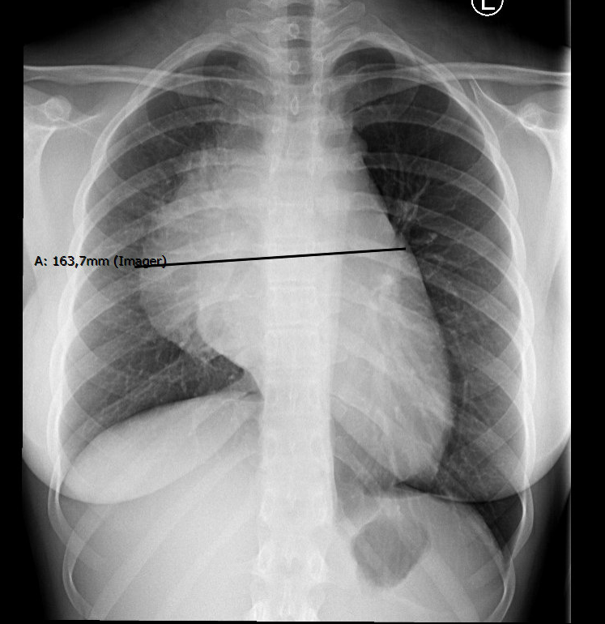
Patiënte B, 18 jaar
xxxxxxxxxxxxxxxxxxxxxxxxxxxxxxxxxxxxxxxxxxxxxxxxxxxxxxxxxxxxxxxxxxxxxxxxxxxxxxxxxxxxxxxxxxxxxxxxxxxxxxxxxxxxxxxxxxxxxxxxxxxxxxxxxxxxxxxxxxxxxxxxxxxxxxxxxxxxxxxxxxxxxxxxxxxxxxx
Blanco voorgeschiedenis
Anamnese
  Progressieve moeheid, oedeem van het gelaat
  Sinds 2 weken hoest en dyspnoe
  Thoracale pijn
Lichamelijk onderzoek
  BD 110/70 pols 92/min, Temp. 36,7 °C, RR 28/min, Sat 97%
  Hart: S1/S2, geen souffle
  Long: geen crepitaties/rhonchi
Notes:
The second case is a 18 year old female. She presented with progressive tiredness, swelling of the face and general malaise. She also experienced a pressing feeling on her chest and she was couphing.
There was as well dyspnoe, she had trouble with talking and walking at the same time.
Physical examination was normal with no lymfadenopathy.
An X-ray of the thorax showed mediastinal widening and an enlarged heart.

Slide 6
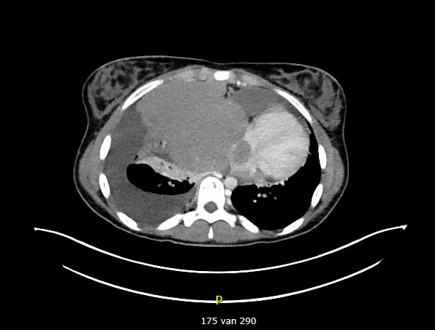
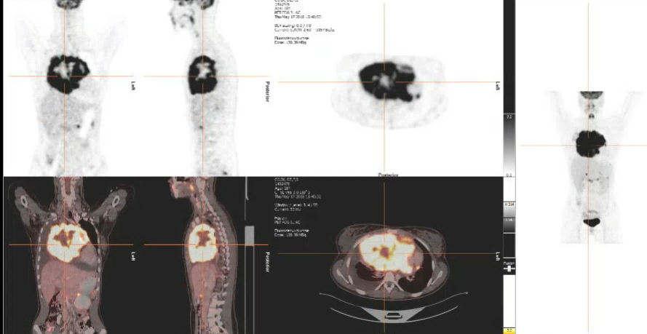
Patiënte B, 18 jaar
xxxxxxxxxxxxxxxxxxxxxxxxxxxxxxxxxxxxxxxxxxxxxxxxxxxxxxxxxxxxxxxxxxxxxxxxxxxxxxxxxxxxxxxxxxxxxxxxxxxxxxxxxxxxxxxxxxxxxxxxxxxxxxxxxxxxxxxxxxxxxxxxxxxxxxxxxxxxxxxxxxxxxxxxxxxxxxx
PET CT
Grote tumor in het mediastinum (12,6 x 11,8 x 9,8 cm) betrokkenheid van pericard en rechter atrium
TTE hart
Compressie van het rechter atrium zonder flow belemmering
Histologie
Lokalisatie van een B-cel NHL geclassificeerd als primair mediastinaal B-cel lymfoom
Notes:
PET CT showed a very large tumor in the mediastinum superior anterior estimated volume 750cc.
There is involvement of the pericardium and right atrium. With a tumortrombus in the right atrium. There was pericardial and pleural effusion. And the tumor caused compression on the left atrium, the pulmonal artery, the vena pulmonalis and caused an occlusion of the vena cava superior and vena brachiocephalica. In the abdomen there was a suspect localisation in the right adrenal gland and in the pancreas.
A subsequent ultrasound of the heart showed compression of the right atrium and right pulmonary artery.
Histological examination shows a localisation of a B cell non hodgkin lymfoom classified as primary mediastinal large B cell lymphoma.
Thorax:
Groei van het intense inhomogeen FDG-opnemend proces in het voorste mediastinum maximale afmetingen het axiale vlak nu 15,9 x 10,4 (IMA 193/290) en dit was en 15,3 x 9,8 cm. Centrale hypodens en minde FDG opname passend bij necrose. Bekende uitbreiding in pericard en rechteratrium met tumor thrombus doorsnede van 2,8 cm in het rechteratrium (IMA 175/290). Toename van pericardvocht. Toename van shift van hart naar links. Hierbij compressie op het linkeratrium en de vena en arteria pulmonalis rechts. Occlusie vena cava superior en de vena brachiocephalica rechts. Compressie carina en beide hoofdbronchiën rechts meer dan links. Toename pleuravocht rechts. Toename obstructie en compressie-atelectase R long. Verdikte interlobulaire septa in de rechterbovenkwab passend bij stuwing door afvloedbelemmering. Wigvormige consolidatie perifeer in rechterbovenkwab is verplaatst onder invloed van compressie qua omvang toegenomen.
Normale luchthoudendheid van de linkerlong.
Abdomen:
Focale intense FDG-opname net craniaal en caudaal van de rechterbijnier doorsnede 0,7 cm (IMA 133, 147/290) dit was 0,6 cm.
Versterkte aankleuring met intense FDG-opname in het corpus van het pancreas direct aangrenzend hypodens gebied mogelijk oedeem. FDG-opname blijft een doorsnede van 1,9 cm (IMA 122/290). Op de grens van pancreasstaart en maag streepvormige intense FDG-opname zonder substraat op CT. Dit gebied is positief op NAC opname. Soortgelijke focale minder intense FDG-opname langs de fundus/corpus van de maag (IMA 127, 152/290).
In de lever en milt fysiologische FDG opname. Normaal aspect van bijnieren en nieren. Para hart, para-iliacaal en mesenteriaal geen vergrote lymfeklieren. Verhoogde FDG-opname het rectosigmoïd (IMA 61/290). Normaal aspect van uterus en adnexen. Spoor vocht in Douglas.
Skelet:
Geen lymfoomlokalisaties.
Conclusie:
1) Zeer groot invasief groeiend intens metabool actief ruimte-innemend proces in het voorste mediastinum met invasie van pericard en rechteratrium, compressie op linkeratrium, arteria, vena pulmonalis rechts en hoofdbronchien. Occlusie VCS. Passend bij bekend B-cel lymfoom.
2) Bekend tumorthrombus in de rechteratrium.
3) Toename pericard en pleuravocht.
4) Verdenking lymfoomlokalisatie in corpus van het pancreas met aangrenzend oedeem.
5) Matige actieve niet vergrote lymfeklieren rond de rechterbijnier. Mogelijk lymfoomlokalisaties.
6) Toename wigvormige consolidatie rechterbovenkwab d.d. longinfarct post obstructie pneumonie. Tevens toename tekenen van stuwing voor afvloedbelemmering.
Biopten laesie mediastinum: lokalisatie B-cel non-Hodgkinlymfoom, mede
gezien de aankleuring met CD23 en de lokalisatie in het mediastinum
bij voorkeur te classificeren als primair mediastinaal (thymisch)
grootcellig B-cellymfoom. Aanvullend moleculair onderzoek volgt.
Moleculair onderzoek :
Aanvulling d.d. 06-04-2018:
Middels FISH geen breuken aantoonbaar in BCL2, BCL6 of MYC.
Aanvulling d.d. 13-04-2018:
Uit het weefsel werd DNA geïsoleerd. Bij
B-celreceptorgenherschikkingsanalyse werd een evidente clonale
B-celexpansie aangetroffen

Slide 7
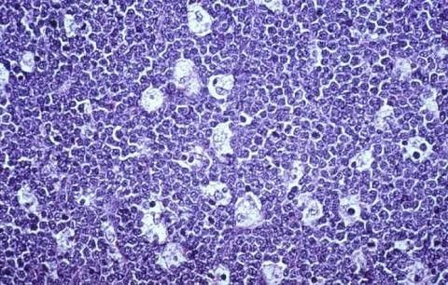
Patiënt C, 44 jaar
xxxxxxxxxxxxxxxxxxxxxxxxxxxxxxxxxxxxxxxxxxxxxxxxxxxxxxxxxxxxxxxxxxxxxxxxxxxxxxxxxxxxxxxxxxxxxxxxxxxxxxxxxxxxxxxxxxxxxxxxxxxxxxxxxxxxxxxxxxxxxxxxxxxxxxxxxxxxxxxxxxxxxxxxxxxxxxx
Voorgeschiedenis
Jicht
2016 HIV start triumeq, April 2018 stop cART (spierpijn)
Anamnese
Misselijkheid, vol gevoel, spierpijn, afvallen
Lichamelijk onderzoek
  BD 103/101 mmHg, pols 98/min
  Hart: S1/S2: geen souffle
  Pulm: VAG
  Abdomen: massa linker abdomen
  Vergrote testes
www.pathologystudent.com
Notes:
The third case is a a 44 year old male who was referred to our hospital with a recently diagnosed Burkitt lymphoma. He presented with nausea, weight loss (14kilo’s in 6 weeks), muscle pain and an abdominal mass.
Physical examination revealed a little bit increased bloodpressure and pulse rate. He had normal heart sounds and no murmer was heard. There was an abdominal mass palpable. There was no lymfadenopathy in neck, axillae or groin. Both testiclces were enlarged. Contrast computed tomography revealed a large mass in the upper part of the abdomen and there was a suggestion of cardiac involvement.
On the right a beautifulle pathology picture typical of Burkitt lymphoma. It is also called starry sky. You see macrofages who…
nother such term is “starry-sky pattern.” In Burkitt lymphoma (which is, by the way, the same thing as B-cell acute lymphoblastic leukemia), the histologic sections have a unique appearance at low power, as seen in the above image. The tumor cells, which are large with minimal cytoplasm, are closely apposed to each other, forming a dark blue background (the “sky”). These cells have a very high turnover rate, so the macrophages that happen to be hanging around get stuffed with cellular debris (they are at this point called “tingible body macrophages”), and upon fixation, the cytoplasm falls away, leaving round white spaces filled with debris (the “stars”). This pattern can be seen on both bone marrow or lymph node sections, and it is quite specific for Burkitt lymphoma
We made a PET CT who showed multiple FDG positive lesions. A large mass in the left hemiabdomen with involvement of the pancreas, colon, left kidney and left adrenal gland. There were enlarged lymph nodes para iliacal. The PET CT also showed involvement of the testes muscle and bone. And also of the right atriu, seen on the right upper picture.
We performed a transthoracal ultrasound which showed a mass in the lateral wall of the right atrium partly intraluminal passing through the tricuspid valve without causing obstruction. There was also pericardial effusion.
A MRI heart showed again the mass in the right atrium with the intraluminal part. But also showed infiltration of the right ventricle.

Slide 8
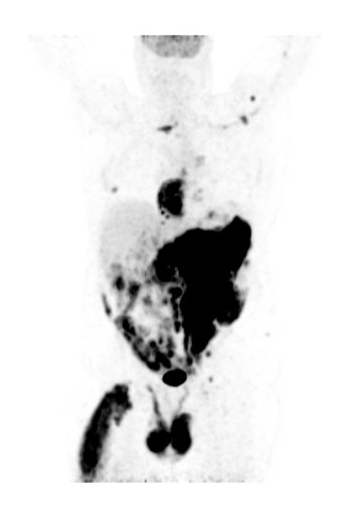
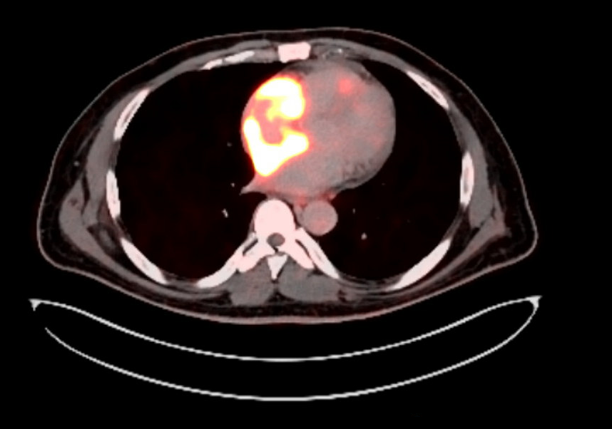
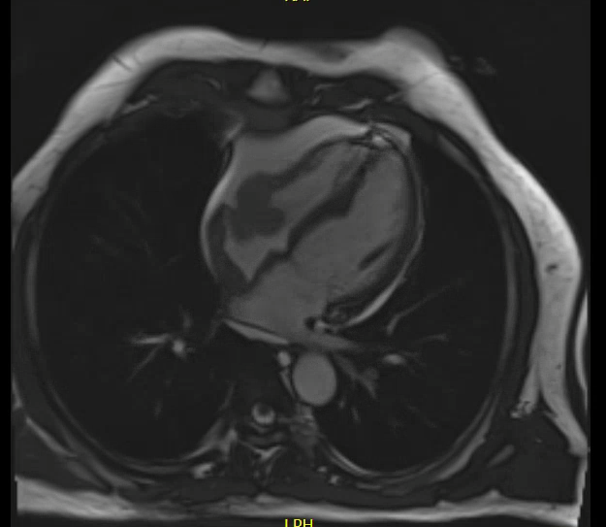
Patiënt C, 44 jaar
xxxxxxxxxxxxxxxxxxxxxxxxxxxxxxxxxxxxxxxxxxxxxxxxxxxxxxxxxxxxxxxxxxxxxxxxxxxxxxxxxxxxxxxxxxxxxxxxxxxxxxxxxxxxxxxxxxxxxxxxxxxxxxxxxxxxxxxxxxxxxxxxxxxxxxxxxxxxxxxxxxxxxxxxxxxxxxx
PET CT
Grote PET-avide massa in het li hemiabdomen
lokalisatie in het rechter atrium
TTE hart
  Massa in de wand van het rechter atrium
  Pericardeffusie van 0.8 cm
MRI hart
  Infiltratie van de wand van het rechter atrium en ventrikel met tevens een intraluminale massa
Notes:
The third case is a a 44 year old male who was referred to our hospital with a recently diagnosed Burkitt lymphoma. He presented with nausea, weight loss (14kilo’s in 6 weeks), muscle pain and an abdominal mass.
Physical examination revealed a little bit increased bloodpressure and pulse rate. He had normal heart sounds and no murmer was heard. There was an abdominal mass palpable. There was no lymfadenopathy in neck, axillae or groin. Both testiclces were enlarged. Contrast computed tomography revealed a large mass in the upper part of the abdomen and there was a suggestion of cardiac involvement.
On the right a beautifulle pathology picture typical of Burkitt lymphoma. It is also called starry sky. You see macrofages who…
We made a PET CT who showed multiple FDG positive lesions. A large mass in the left hemiabdomen with involvement of the pancreas, colon, left kidney and left adrenal gland. There were enlarged lymph nodes para iliacal. The PET CT also showed involvement of the testes muscle and bone. And also of the right atriu, seen on the right upper picture.
We performed a transthoracal ultrasound which showed a mass in the lateral wall of the right atrium partly intraluminal passing through the tricuspid valve without causing obstruction. There was also pericardial effusion.
A MRI heart showed again the mass in the right atrium with the intraluminal part. But also showed infiltration of the right ventricle.

Slide 9
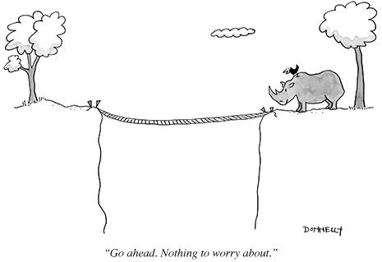
Cardiale lokalisatie van lymfoom
xxxxxxxxxxxxxxxxxxxxxxxxxxxxxxxxxxxxxxxxxxxxxxxxxxxxxxxxxxxxxxxxxxxxxxxxxxxxxxxxxxxxxxxxxxxxxxxxxxxxxxxxxxxxxxxxxxxxxxxxxxxxxxxxxxxxxxxxxxxxxxxxxxxxxxxxxxxxxxxxxxxxxxxxxxxxxxx
Conclusie
  Patiënte A: Stadium IV DLBCL met uitgebreide lokalisatie in het linker en rechter ventrikel
  Patiënte B: Primair mediastinaal B-cel lymfoom met betrokkenheid van het rechter atrium en pericard
  Patiënt C: Stadium IV Burkitt lymfoom met lokalisatie in rechter atrium/ventrikel en pericard
Risico’s?
Consequenties voor behandeling?
Notes:
In conclusion al three patients presented with cardiac involvement of lymphoma.
Paiient 1 had a stage IV difuse large cell B cel lymphoma with left and right ventricle involvement with a large mass leading towards obstructive and cardiogenic shock and she died.
Patient 2 has a primary mediastinal B cel lymphoma with involvement of the right atrium and pericardium laedint towards pericardial effusion
Patient 3 has a stage IV burkitt lymphoma with involvement of the right atrium and ventricle and also pericardium with pericardial effusion

Slide 10

Cardiale lokalisatie van lymfoom
xxxxxxxxxxxxxxxxxxxxxxxxxxxxxxxxxxxxxxxxxxxxxxxxxxxxxxxxxxxxxxxxxxxxxxxxxxxxxxxxxxxxxxxxxxxxxxxxxxxxxxxxxxxxxxxxxxxxxxxxxxxxxxxxxxxxxxxxxxxxxxxxxxxxxxxxxxxxxxxxxxxxxxxxxxxxxxx
Primair cardiaal (n=51)
Secundaire betrokkenheid (n=43)
  De novo lymfoom van het myocardium/pericardium zonder lymfklier of milt betrokkenheid
  1,3% van alle primaire cardiale tumoren
  Man 65%
  Leeftijd 59.4 ± 2.1 jaar
  Immunodeficiëntie is een risico factor
  DLBCL meest frequent (71%)
  Incidentie van 9-24% (autopsie studies)
  Man 67%
  Leeftijd 50.2 ± 2,7 jaar
  Immunodeficiëntie is een risico factor
  DLBCL meest frequent (42%)
  T cel lymfoom (33%)
Gordon et al. Eur J Haematology, 2016
Notes:
Searching pubmed for studies was dissapointing. Only case reports and some case series could be found regarding cardiac lymphoma. There a couple of reviews written who retrospectively analyzed these case reports. The data on this slide were presented in one of these studies.
In this retrospective study 94 cases of lymphoma with cardiac involvement were analyzed. 51 primary cardiac lymphoma’s. And 43 patients had secondary cardiac involvement at the intitial diagnosis of NHL. The WHO defines this as a de novo lymphoma with a localisation in myocardium and or pericardium without lymphnode or splenic involvement.
Primary cardiac lymphoma is extremely rare with a frequency of 1,3% of all primary cardiac tumors and 0,5% of all lymphoma’s.
Compared to primary cardiac lymphoma, secondary cardiac involvement in malignant lymphoma is more common. An incidence up to 24% is described in autopsy studies.
Patients with primary cardiac lymphoma were older. Immunodeficiency is a risk factor in both, DLBCL is most frequent in both. The majority of T cell lymphoma’s were cases with secondary involvement.

Slide 11
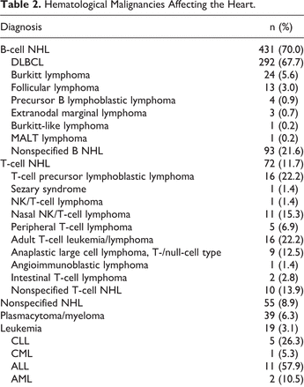
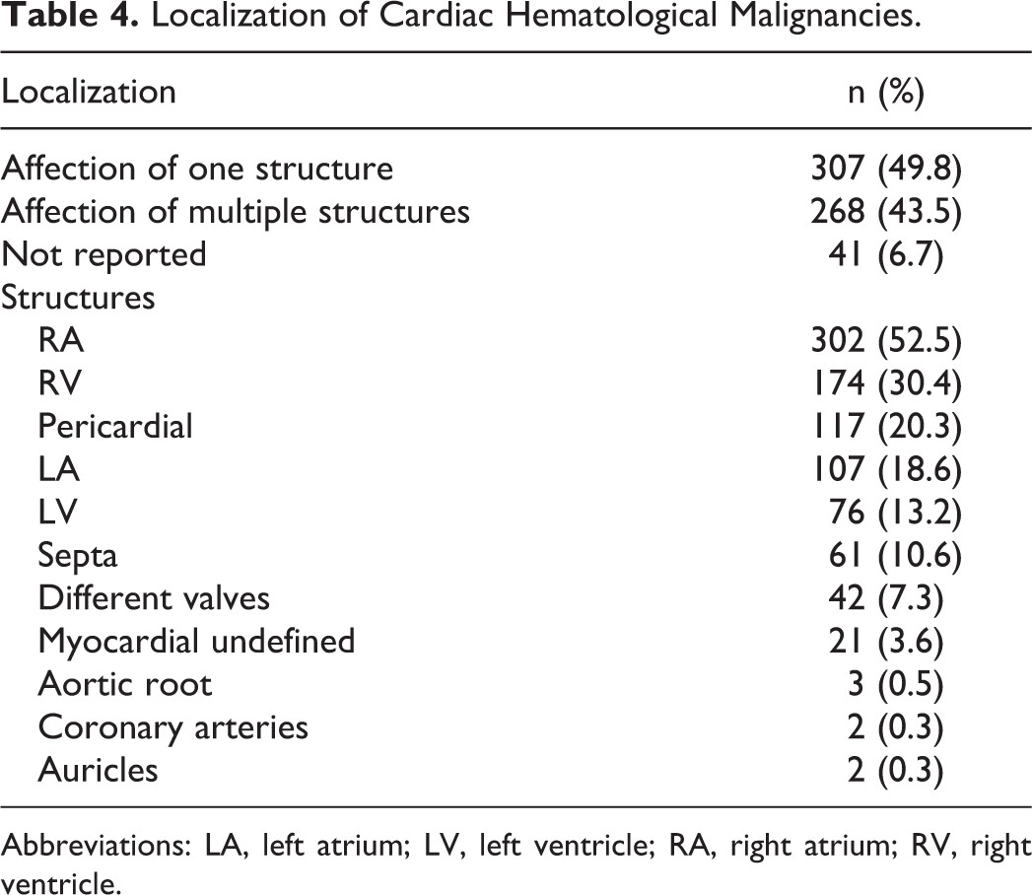
Cardiale lokalisatie van lymfoom
xxxxxxxxxxxxxxxxxxxxxxxxxxxxxxxxxxxxxxxxxxxxxxxxxxxxxxxxxxxxxxxxxxxxxxxxxxxxxxxxxxxxxxxxxxxxxxxxxxxxxxxxxxxxxxxxxxxxxxxxxxxxxxxxxxxxxxxxxxxxxxxxxxxxxxxxxxxxxxxxxxxxxxxxxxxxxxx
B-cel NHL: 431 pat, 70%
T-cel NHL 72 pat, 11,7%
Plasmacytoom 39 pat, 6,3%
Leukemie 19 pat, 3.1%
Voigt et al. Angiology, 2018
Notes:
In this recent article of Voigt et al the pubmed database was searched for cases regarding cardiac hematological malignancies (not only lymphoma’s)—> in total 616 cases were analyzed.
This left table summarizes all the hematological diagnosis found in the heart, indeed B cell non hodgkin lymphoma was diagnosed most frequently (70% van de casus). Cardiac involvement of T cell NHL occured in 11,7% en plasmacytoom of myeloma in 6,3% and different leukemia’s in 3,1%.
Burkitt lymphoma’s are the second most frequent B-cell NHL.
In the right table the localisation of the malignancy is summarized. In almost half of the cases only one structure is affected.
The right atrium followed bij the right ventricle is most frequently affected. Followed by pericardial, left atrium left ventricle.

Slide 12
Cardiale lokalisatie van lymfoom
xxxxxxxxxxxxxxxxxxxxxxxxxxxxxxxxxxxxxxxxxxxxxxxxxxxxxxxxxxxxxxxxxxxxxxxxxxxxxxxxxxxxxxxxxxxxxxxxxxxxxxxxxxxxxxxxxxxxxxxxxxxxxxxxxxxxxxxxxxxxxxxxxxxxxxxxxxxxxxxxxxxxxxxxxxxxxxx
groeipatroon | B- cel lymfoom | T-cel lymfoom | leukemie | plasmacytoom
Geïsoleerde pericardiale lokalisatie | 27 (7,2%) | 11 (17,7%) | 5 (31,2%) | 14 (37,8%)
Intraluminale massa | 207 (55,2%) | 11 (17,7%) | 3 (18,7%) | 14 (37,8%)
Wand infiltratie | 141 (37,6%) | 40 (64,5%) | 8 (50%) | 9 (24,3%)
Voigt et al. Angiology, 2018
Notes:
In dit artikel hebben ze ook het groeipatroon bij de cardiale lymfomen beschreven, dit hebben ze ingedeeld in 3 categorien: geisoleerde pericardiale lokalisatie, een intraluminale massa dan wel wand infiltratie.
Bij het B cel lymfoom werd frequent een intraluminale massa gezien gevolgd door wand infiltratie. Leukemie maar ook het plasmacytoom kunnen zich ook vaak manifesteren met enkel een pericardiale lokalisatie, dit wordt minder vaak bij het B cel lymfoom gezien

Slide 13
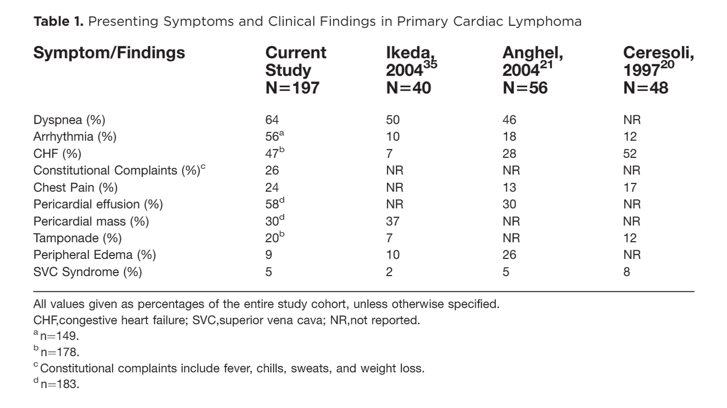
Symptomen bij presentatie
xxxxxxxxxxxxxxxxxxxxxxxxxxxxxxxxxxxxxxxxxxxxxxxxxxxxxxxxxxxxxxxxxxxxxxxxxxxxxxxxxxxxxxxxxxxxxxxxxxxxxxxxxxxxxxxxxxxxxxxxxxxxxxxxxxxxxxxxxxxxxxxxxxxxxxxxxxxxxxxxxxxxxxxxxxxxxxx
Petrich et al. Cancer, 2011
Notes:
In this tabel from an article from Petrich et al the presenting symptoms from 197 patients with primary cardiac lymphoma are listed.
Dyspnoe was here most frequently reported, followed by chestpain en constitutional complaints.
In 149 patients the presenting heart rhythm was reported, in 56% an arrhytmia was described. The 2 most common abnormalities were atrial arrhythmias 23% and atrioventricular block 22%, In addition 16 patients had a bundle branch block and 8 suffered ventricular arrhytmias.
Of 183 patients with appropriate information, 58% had pericardial effusion, 34% of these patients had tamponade physiology.

Slide 14
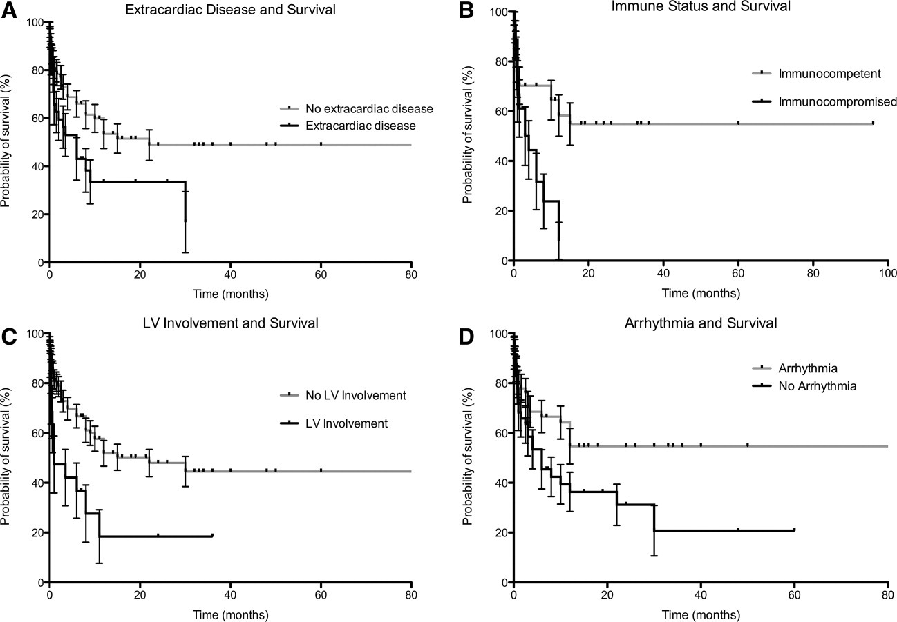
Ritmeproblematiek
xxxxxxxxxxxxxxxxxxxxxxxxxxxxxxxxxxxxxxxxxxxxxxxxxxxxxxxxxxxxxxxxxxxxxxxxxxxxxxxxxxxxxxxxxxxxxxxxxxxxxxxxxxxxxxxxxxxxxxxxxxxxxxxxxxxxxxxxxxxxxxxxxxxxxxxxxxxxxxxxxxxxxxxxxxxxxxx
Pubmed search: cardiac lymphoma AND arrhythmia
Laatste 10 jaar, engels
100 hits, 32 relevante case reports
Ritmeproblematiek kan ook ontstaan tijdens chemotherapie
Meeste ritmeproblematiek verdwijnt ook vlot na start chemotherapie (geen permanente pacemaker plaatsen)
Petrich et al. Cancer, 2011
Notes:
This article also provided data in support of prognostic factors and one of these factors is the presence of arrhytmia. Patients presenting with rythm disturbances survived LONGER than those with normal rhythms. This was also found bij Voigt et al (but not shown)
Possible explanations for this results are:
Patients with arrhytmia more often suffered symptoms that prompted early presentation and earlier imaging and presentation
The detection of arrhythmia upon presentation might have led to a better monitoring?
Mediante overleving van patienten met een artimie werd niet bereikt terwijl de mediane overleving van patienten zonder aritmie 6 maanden was

Slide 15
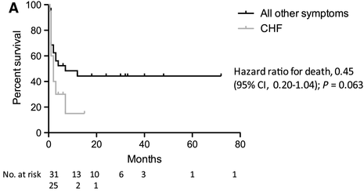
Hartfalen en LV betrokkenheid
xxxxxxxxxxxxxxxxxxxxxxxxxxxxxxxxxxxxxxxxxxxxxxxxxxxxxxxxxxxxxxxxxxxxxxxxxxxxxxxxxxxxxxxxxxxxxxxxxxxxxxxxxxxxxxxxxxxxxxxxxxxxxxxxxxxxxxxxxxxxxxxxxxxxxxxxxxxxxxxxxxxxxxxxxxxxxxx
LV betrokkenheid
hartfalen
Voigt et al. Angiology, 2018 Petrich et al. Cancer, 2011
Notes:
Median OS voor immuungecompromitteerd vs niet = 3,5 mnd versus niet bereikt
LV betrokkenheid mediane overleving 1 maand versus 22 maanden zonder LV betrokkenheid
Hartfalen 7 versus 2 maanden
Met chemotherapie 18 maanden 1 maand zonder chemotherapie, mediane overal survival 3 maanden

Slide 16
Conclusies
xxxxxxxxxxxxxxxxxxxxxxxxxxxxxxxxxxxxxxxxxxxxxxxxxxxxxxxxxxxxxxxxxxxxxxxxxxxxxxxxxxxxxxxxxxxxxxxxxxxxxxxxxxxxxxxxxxxxxxxxxxxxxxxxxxxxxxxxxxxxxxxxxxxxxxxxxxxxxxxxxxxxxxxxxxxxxxx
Primair cardiaal lymfoom en secundaire cardiale lokalisatie zijn zeldzaam
‘Evidence’ is gebaseerd op case reports en case series
DLBLC komt het meest voor
Lokalisatie vooral in het rechter atrium/ ventrikel
Vaak niet-specifieke symptomen → slechte prognose
Kan leiden tot ritmeproblematiek, hartfalen, pericard effusie enz
→ Er zijn geen richtlijnen wat betreft cardiale bewaking
Notes:
Publication bias, when dealing with case reports as a source of data ther is a bias in favor of reporting those cases with unique features and a lack of standardization as to what features should or shoud not be reported.

Slide 17
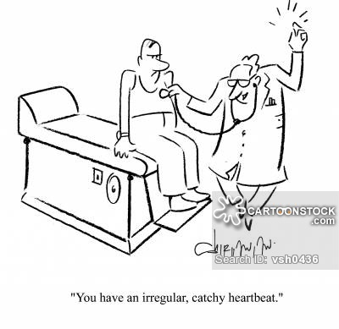
Diagnostische work-up
xxxxxxxxxxxxxxxxxxxxxxxxxxxxxxxxxxxxxxxxxxxxxxxxxxxxxxxxxxxxxxxxxxxxxxxxxxxxxxxxxxxxxxxxxxxxxxxxxxxxxxxxxxxxxxxxxxxxxxxxxxxxxxxxxxxxxxxxxxxxxxxxxxxxxxxxxxxxxxxxxxxxxxxxxxxxxxx
Samenwerking met cardiologie en intensive care unit
Denk aan een cardiaal lymfoom/lokalisatie cardiaal bij:
Onverklaarde aritmie/ hartfalen/ pericard effusie
Cardiale afwijkingen op (PET) CT bij work-up lymfoom
Work-up
ECG
TTE (or TEE)
MRI hart (or CT hart)

Slide 18
Monitoring/behandeling
xxxxxxxxxxxxxxxxxxxxxxxxxxxxxxxxxxxxxxxxxxxxxxxxxxxxxxxxxxxxxxxxxxxxxxxxxxxxxxxxxxxxxxxxxxxxxxxxxxxxxxxxxxxxxxxxxxxxxxxxxxxxxxxxxxxxxxxxxxxxxxxxxxxxxxxxxxxxxxxxxxxxxxxxxxxxxxx
Geen additionele/specifieke chemotherapie
High risk patiënten
  presentatie met ventriculaire aritmie (NSVTs, VTs, >1000 VESs/dag)
  AV blok (2e en 3e graads)
  Hartfalen (EF <40%)
  Pericard effusie/tamponade
  Lymfoom lokalisatie in linker of rechter ventrikel
  Obstruerende intraluminale massa
Geef eerste 3 chemokuren onder telemetrische en hemodynamische bewaking.
Na elke cyclus: TTE + ECG ter follow up, na 3 cycli MRI or CT hart herhalen.
Notes:
In article of Voigt et al clinical signs were available for 590 patients (primary cardiac and secondary cardiac involvement, not only lymphoma’s). They presented with a broad spectrum of symptomen, again most frequently dyspnae was found followed by arrhytmias.
However, in this article the type of arrhytmia is not described.

Slide 19
Follow up patiënten
xxxxxxxxxxxxxxxxxxxxxxxxxxxxxxxxxxxxxxxxxxxxxxxxxxxxxxxxxxxxxxxxxxxxxxxxxxxxxxxxxxxxxxxxxxxxxxxxxxxxxxxxxxxxxxxxxxxxxxxxxxxxxxxxxxxxxxxxxxxxxxxxxxxxxxxxxxxxxxxxxxxxxxxxxxxxxxx
  Patiënte B
  Heeft 2 cycli DA-EPOCH-R ontvangen
  Geen ritme of hemodynamische problematiek
  Patiënt C
  Heeft R-CODOX-M /R-IVAC/ R-CODOX-M/ R-IVAC kuren gehad
  Geen ritme of hemodynamische problemen
  Na 3 chemokuren werd een MRI hart gemaakt: laesie 68x41mm → 21x20mm
  Laatste kuur werd gegeven zonder ritme of hemodynamische observatie
  PET CT toont complete remissie
Notes:
In article of Voigt et al clinical signs were available for 590 patients (primary cardiac and secondary cardiac involvement, not only lymphoma’s). They presented with a broad spectrum of symptomen, again most frequently dyspnae was found followed by arrhytmias.
However, in this article the type of arrhytmia is not described.

Slide 20
xxxxxxxxxxxxxxxxxxxxxxxxxxxxxxxxxxxxxxxxxxxxxxxxxxxxxxxxxxxxxxxxxxxxxxxxxxxxxxxxxxxxxxxxxxxxxxxxxxxxxxxxxxxxxxxxxxxxxxxxxxxxxxxxxxxxxxxxxxxxxxxxxxxxxxxxxxxxxxxxxxxxxxxxxxxxxxx
  Dank aan:
  dr. M.N. Lauw, fellow hematologie
  prof. dr. M.J. Kersten, hematoloog
  dr. J. Horn, intensivist
  dr. W.E.M. Kok, cardioloog

Slide 21

xxxxxxxxxxxxxxxxxxxxxxxxxxxxxxxxxxxxxxxxxxxxxxxxxxxxxxxxxxxxxxxxxxxxxxxxxxxxxxxxxxxxxxxxxxxxxxxxxxxxxxxxxxxxxxxxxxxxxxxxxxxxxxxxxxxxxxxxxxxxxxxxxxxxxxxxxxxxxxxxxxxxxxxxxxxxxxx

